Slide 1
SQL: Advanced Queries
Database Systems
Department of Computer Science, CBNU
Prof. Nasridinov Aziz (aziz@chungbuk.ac.kr)

Slide 2
Last Lecture
MySQL constraints
  SQL constraints are used to specify rules for the data in a relation
  MySQL constraints
    NOT NULL
    PRIMARY KEY
    FOREIGN KEY
    UNIQUE
    CHECK
    DEFAULT

Slide 3
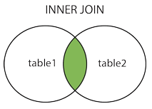
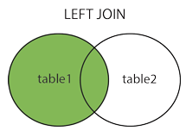
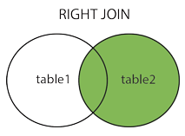
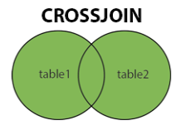
Last Lecture
Join Query
  Combines tuples from two or more relations based on a common attribute

Slide 4
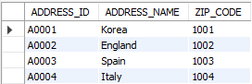
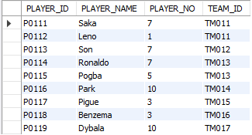
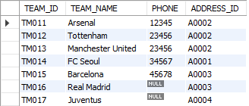
Last Lecture
Join Query (Example)
  Q1: Find the team name for each player
The ADDRESS relation
The PLAYER relation
The TEAM relation

Slide 5
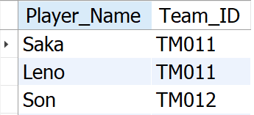
Last Lecture
Join Query (Example)
  Q1: Find the team name for each player
  Easy Solution
    SELECT Player_Name, Team_ID
    FROM Player;
  Problem with this solution
    Only retrieves the Team_ID, but we DO NOT know the team names

Slide 6
Last Lecture
Join Query (Example)
  Q1: Find the team name for each player
  Best Solution
    Join PLAYER and TEAM tables
      STEP 1: Find the common attributes
The TEAM relation
The PLAYER relation

Slide 7
Last Lecture
Join Query (Example)
  Q1: Find the team name for each player
  Best Solution
    Join PLAYER and TEAM tables
      STEP 2: Set up the join condition
    SELECT P. Player_Name, T.Team_Name
    FROM Player P
    JOIN Team T ON P.Team_ID = T.Team_ID;
JOIN condition

Slide 8
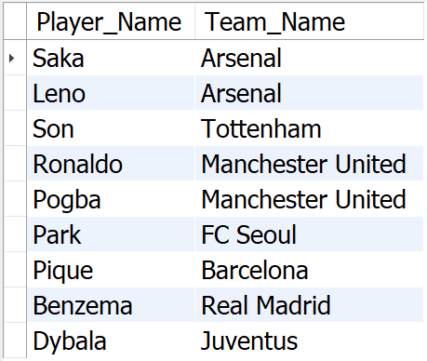
Last Lecture
Join Query (Example)
  Q2: Find the number of players in each team
  Best Solution
    Group the players by teams
      STEP 1: Find the attribute to make groups

Slide 9
Last Lecture
Join Query (Example)
  Q2: Find the number of players in each team
  Best Solution
    Group the players by teams
      STEP 2: Add aggregation function
    SELECT P. Player_Name, count(T.Team_Name) AS PlayerCounter
    FROM Player P
    JOIN Team T ON P.Team_ID = T.Team_ID
    GROUP BY T.Team_Name;

Slide 10
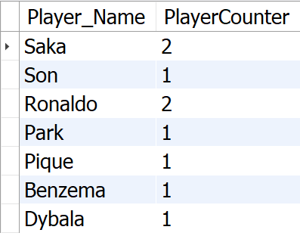
Last Lecture
Join Query (Example)
  Q2: Find the number of players in each team
  Best Solution
    Group the players by teams

Slide 11
Table of Contents
Advanced DDL
  Referential actions
Advanced DML
  Nested queries
Summary and Discussions

Slide 12
Advanced DDL
Part 1

Slide 13
1. Advanced DDL
Referential Actions
  UPDATE or DELETE operation may affect a primary key value in the parent relation that has matching tuples in the child relation
    Suppose that you want to delete department 3 from DEPARTMENT relation. What will happed to matching tuples in the EMPLOYEE relation?
?
?

Slide 14
1. Advanced DDL
Referential Actions
  The result of UPDATE and DELETE depends on the referential actions of FOREIGN KEY constraint
    CASCADE, NO ACTION, RESTRICT, SET NULL, SET DEFAULT
  Referential actions must be added to the FOREIGN KEY constraint
DELETE
  ON DELETE CASCADE
  ON DELETE NO ACTION
  ON DELETE RESTRICT
  ON DELETE SET NULL
  ON DELETE SET DEFAULT
UPDATE
  ON UPDATE CASCADE
  ON UPDATE NO ACTION
  ON UPDATE RESTRICT
  ON UPDATE SET NULL
  ON UPDATE SET DEFAULT

Slide 15
1. Advanced DDL
Creating a table with referential actions
  Example
    CREATE TABLE employee(
    empno int NOT NULL,
    empname varchar(45),
    dno int,
    CONSTRAINT FK_Department_Employee
    FOREIGN KEY (dno)
    REFERENCES department(deptno) ON DELETE CASCADE
    );

Slide 16
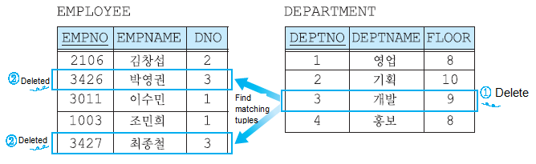
1. Advanced DDL
Referential Actions – CASCADE
  Delete or update the tuples from the parent relation and automatically delete or update the matching tuples in the child relation
  In MySQL, you can specify CASCADE action for delete as follows:
    ON DELETE CASCADE

Slide 17
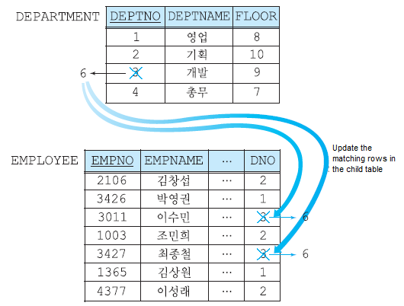
1. Advanced DDL
Referential Actions – CASCADE
  In MySQL, you can specify CASCADE action for update as follows:
    ON UPDATE CASCADE

Slide 18
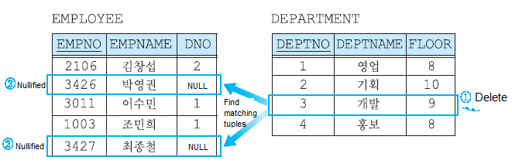
1. Advanced DDL
Referential Actions – SET NULL
  Delete or update the tuples from the parent relation and set the foreign key attribute(s) in the child relation to NULL
  In MySQL, you can specify CASCADE action as follows:
    ON DELETE SET NULL
    ON UPDATE SET NULL

Slide 19
1. Advanced DDL
Referential Actions – RESTRICT and NO ACTION
  Rejects the delete or update operation for the parent relation
  In MySQL, both RESTRICT and NO ACTION are equivalent
    ON DELETE RESTRICT or ON DELETE NO ACTION
    ON UPDATE RESTRICT or ON UPDATE NO ACTION
Referential Actions - SET DEFAULT
  Currently, MySQL does not support SET DEFAULT action

Slide 20
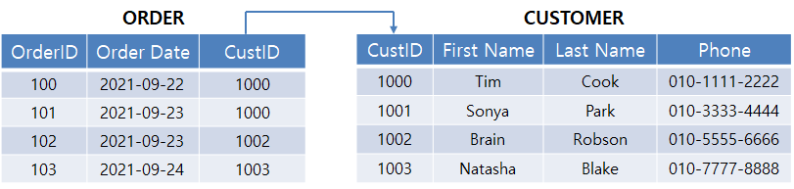
Quiz
Quiz
  Given the following relational database with two relations. Describe what happens to the ORDER relation in the following cases:
  Delete customer with ID 1003 (CustID = 1003) from CUSTOMER relation when referential action is CASCADE.
  Delete customer with ID 1002 (CustID = 1002) from CUSTOMER relation when referential action is RESTRICT.
  Delete customer with ID 1000 (CustID = 1000) from CUSTOMER relation when referential action is SET NULL.
  Delete customer with ID 1001 (CustID = 1001) from CUSTOMER relation when referential action is CASCADE.

Slide 21
Advanced DML
Part 2

Slide 22
2. Intermediate DML
Nested query
  SELECT that appears inside another SQL statement
    Also called subquery
  Where they can appear
    WHERE / HAVING (most common)
    FROM (as a derived table)
    SELECT list
    INSERT, UPDATE, DELETE

Slide 23
Advanced DML
Advantages of Nested Queries
  Improves Readability and Logical Flow
  Enables Stepwise Filtering
  Useful for Complex Scenarios
Disadvantages of Nested Queries
  Often slower
  Harder to optimize
  JOIN is preferred when two tables are queried

Slide 24
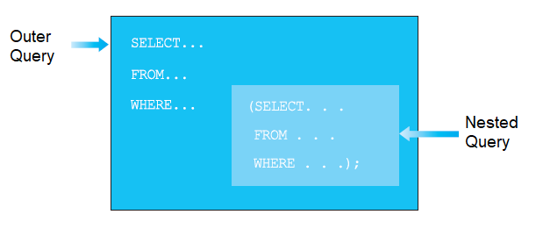
2. Intermediate DML
Nested Query
  SELECT statement included in the WHERE statement
  The result of a nested query can return one of the followings
    A single value
    A relation with one attribute
    A relation with multiple attributes

Slide 25
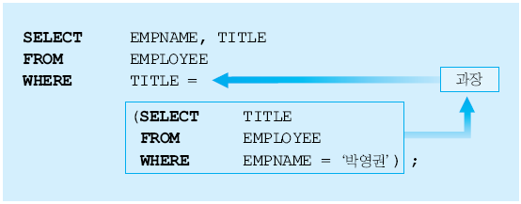
2. Intermediate DML
Nested Query - When a single value is returned
  Example: Retrieve the names and titles of all employees with the same title as 박영권.
  The result of example query

Slide 26
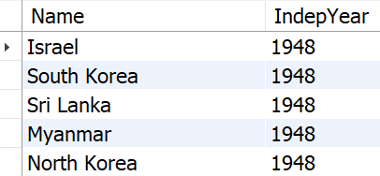
2. Intermediate DML
Nested Query - When a single value is returned
  Q1: Countries that have the same independence year with South Korea
    SELECT Name, IndepYear
    FROM Country
    WHERE IndepYear =
    (SELECT IndepYear
    FROM Country
    WHERE Name = 'South Korea');
  Result

Slide 27
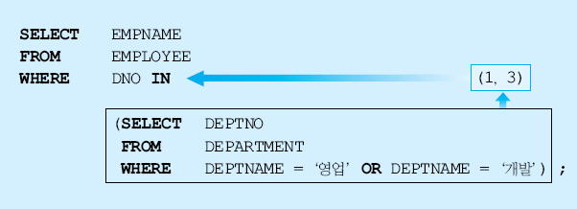
2. Intermediate DML
Nested Query – When a relation with one attribute is returned
  When a relation with one attribute is returned, use IN, ANY, ALL operators in WHERE statement
  Example
    Search for the names of employee who work in Sales or Development departments

Slide 28
2. Intermediate DML
Nested Query – When a relation with one attribute is returned
  Note that most of the nested queries can be written using JOIN
  Previous example can be rewritten as
    SELECT E.EMPNAME
    FROM EMPLOYEE AS E
    JOIN DEPARTMENT AS D ON E.DNO = D.DEPTNO
    WHERE D.DEPTNAME IN ('영업', '개발');

Slide 29
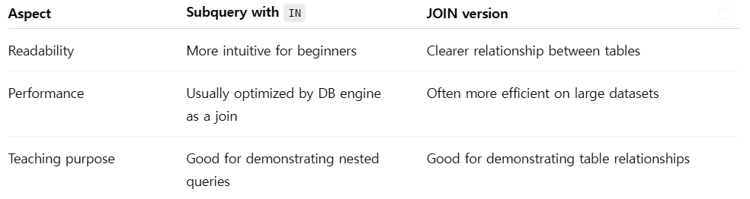
2. Intermediate DML
Nested Query – When a relation with one attribute is returned
  Use the subquery form to explain the concept of nested queries
  Use the JOIN form to show how table relationships can replace subqueries for clarity and performance
  Nested Queries vs. JOIN queries

Slide 30
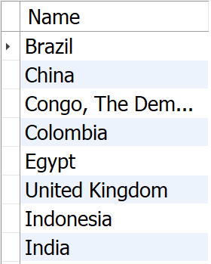
2. Intermediate DML
Nested Query - When a relation with one attribute is returned
  Q2: Find countries in Asia that have cities with population of more than 5 million
    SELECT C.Name
    FROM Country C
    WHERE C.Code IN (SELECT T.CountryCode
    FROM City T
    WHERE T.Population > 5000000);
  Result

Slide 31
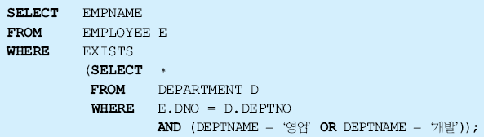
2. Intermediate DML
Nested Query – When a relation with multiple attribute is returned
  When a relation with multiple attribute is returned, use EXIST operator in WHERE statement
  Example
    Search for the names of employee who work in Sales or Development departments

Slide 32
Advanced DML
Nested Queries (Derived Table)
  Derived Table
    Temporary table created from a subquery in the FROM clause
      It is not stored in the database; it exists only while the outer query runs
  Syntax
    SELECT ...
    FROM ( <subquery> ) AS derived_table
    WHERE ...

Slide 33
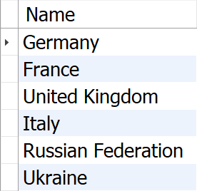
Advanced DML
MySQL Nested Queries (Derived Table)
  Q3: Find all countries in Europe with population more than 50 million
  Query
    SELECT C.Name
    FROM (SELECT Name, Continent
    FROM Country
    WHERE Population >50000000)
    AS C
    WHERE C.Continent = 'Europe' ;

Slide 34
Advanced DML
MySQL Nested Queries (Derived Table)
  Note that you can create above query using more simple version
  More simple version
    SELECT Name, Continent
    FROM Country
    WHERE Population >50000000
  Then, why derived table is useful?
    It makes the query more simple or clear

Slide 35
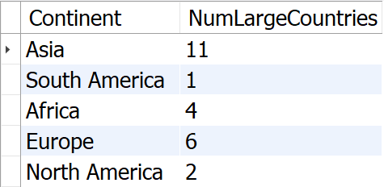
Advanced DML
MySQL Nested Queries (Derived Table)
  Q4: Count large countries by population and group them by continents
  Query
    SELECT Continent, COUNT(*) AS NumLargeCountries
    FROM (
    SELECT Name, Continent
    FROM Country
    WHERE Population > 50000000
    ) AS C
    GROUP BY Continent;

Slide 36
See you next time
Questions?

